Slide 1
Sorting

Slide 2
Outline
Problem Definition
Internal Sorting Algorithms
Insertion Sort
Quick Sort
Merge Sort
Heap Sort
Radix Sort
External Sorting Algorithms
K-way Merging
Notes:
2

Slide 3
Why Sorting?
Sequential Search
The list may be unordered
Example: 15, 4, 17, 26, 30, 46, 48, 56, 58, 82, 90
Search in sequence until the correct record is located
Unsuccessful search: n+1 ➔ O(n)
Average successful search:
Notes:
3

Slide 4
Why Sorting?
Binary Search
The list must be ordered
Example: 4, 15, 17, 26, 30, 46, 48, 56, 58, 82, 90
discard ½ of the list for each unsuccessful search:
Unsuccessful search: O(log n)
Worst case successful search: O(log n)
Notes:
4

Slide 5
Best Sorting Algorithm?
No single sorting technique is the “best”
Best/worst/average time complexity
Issues to consider
Availability of computing resources
CPU speed, available memory
Real-time vs. off-line
Properties about the data
Randomness of the data (is it partially ordered)
Sizes of the list being sorted
Stability requirement
Notes:
5

Slide 6
Classifications of Sorting Algo.
Internal sort
The list is small enough to sort entirely in main memory
Speed usually bounded by algorithm complexity
External sort
The data is too large to fit into main memory
Speed usually bounded by I/O
Notes:
6

Slide 7
Insertion Sort

Slide 8
Insertion Sort (1/3)
Concept
insert a record R into a sequence of ordered records, R₀, R₁, …, R_{i-1} (K₀ ≤ K₁ ≤, …, ≤ K_{i-1}) in such a way that
the resulting sequence of size i+1 is also ordered
Algorithm
For i := 1 to n
Insert R_{i} into the correct position in the list R₀, …, R_{i-1}
Notes:
8

Slide 9
Insertion Sort (2/3)
Implementation
Array data structures: simple implementation
Linked list data structure: reduces insert time
Notes:
9

Slide 10
Insertion Sort (3/3) Array Structure
i =
1
3
4
2
next =
3
1
4
2
list
[0]
[1]
[2]
[3]
[4]
5
2
1
2
5
3
2
3
5
3
1
5
4
4
5
void insertion_sort (element list[], int n)
/* perform a insertion sort on the list */
{
int i, j;
element next;
for (i=1; i<n; i++) {
next = list[i];
for (j=i-1; j>=0 && next.key<list[j].key; j--)
list[j+1] = list[j];
list[j+1] = next;
}
}
Notes:
10

Slide 11
Practice Time
Please sort the following data sequence by insertion sort
6 5 3 1 8 7 2 4

Slide 12
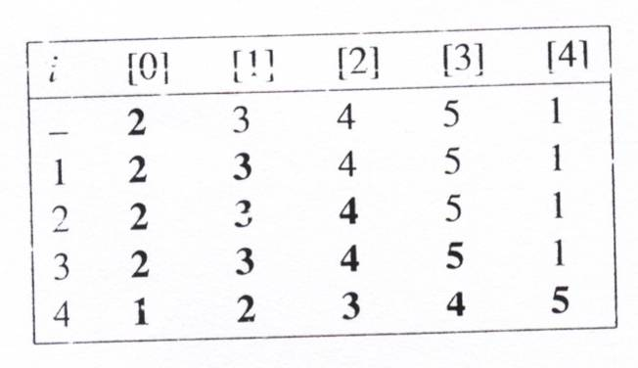
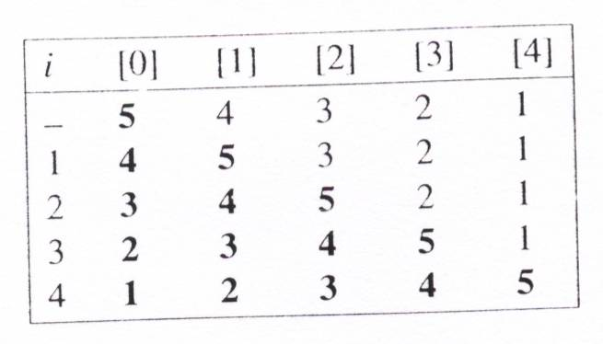
Insertion Sort (3/3) Time Complexity Analysis
If k is the number of records left out of order (LOO), then the computing time is O(kn)
The worst-case time is O(n²).
The average time is O(n²).
The best time is O(n).
left out of order (LOO)
k=1
k=4
Notes:
12

Slide 13
Quick Sort

Slide 14
Quick Sort: Concept
Given (R₀, R₁, …, R_{n-1}) and let R_{i} denote a pivot key
Reposition all (R₀, R₁, …, R_{n-1}) so that
R_{i} is positioned at s(i), renamed as R_{s(i)}
all entries before s(i) is smaller than or equal to R_{s(i)} and
all entries after s(i) is larger than or equal to R_{s(i)}
After a repositioning, the original list is partitioned into two sublists
{R₀, …, R_{s(i)-1}}, R_{s(i)}, {R_{s(i)+1}, …, R_{s(n-1)}}
Sort the two lists independently
Notes:
14

Slide 15
Quick Sort: Example
Select a pivot key: first entry in the list
Interchange the elements to their correct positions according to the pivot
Repeat the procedure on the lists before and after the pivot
R₀
R₁
R₂
R₃
R₄
R₅
R₆
R₇
R₈
R₉
26
5
37
1
61
11
59
15
48
19
11
5
19
1
15
26
59
61
48
37
1
5
11
19
15
26
59
61
48
37
1
5
11
19
15
26
59
61
48
37
1
5
11
15
19
26
59
61
48
37
1
5
11
15
19
26
48
37
59
61
1
5
11
15
19
26
37
48
59
61
1
5
11
15
19
26
37
48
59
61
Notes:
15

Slide 16
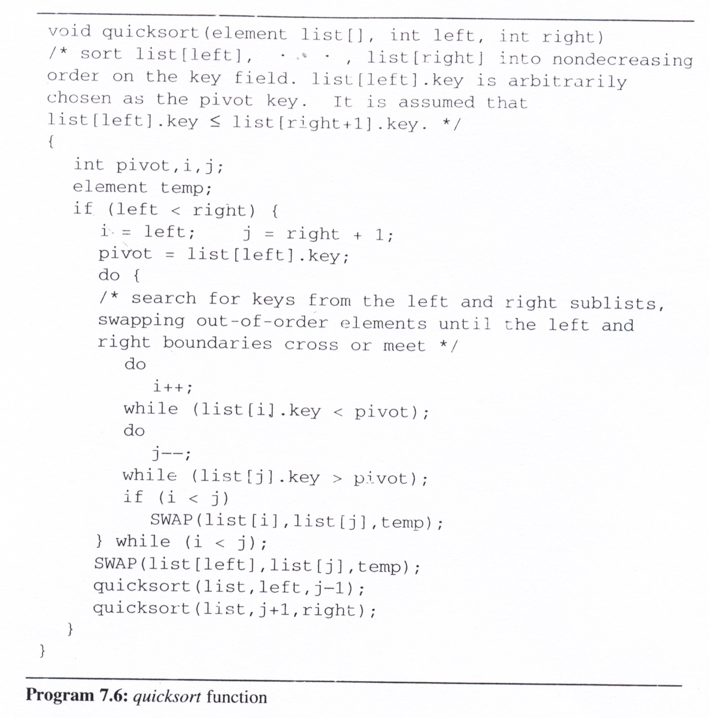
Quick Sort: Implementation
0
1
0
3
5
3
0
6
8
6
9
6
left
0
right
-1
9
4
1
4
4
9
6
7
9
1
3
7
i:
j:
pivot=
26
11
1
19
59
48
R₀
R₁
R₂
R₃
R₄
R₅
R₆
R₇
R₈
R₉
19
37
26
61
11
1
1
5
37
19
1
11
1
19
15
61
15
19
11
26
59
48
37
15
61
37
48
48
59
Notes:
16

Slide 17
Practice Time
Please sort the following data sequence by quick sort
6 5 3 1 8 7 2 4

Slide 18
Quick Sort: Analysis
Assumptions
each time a record is positioned, the list is divided into two sublists, roughly of the same size
Let T(n) be the time taken to sort n elements
T(n) <= cn+2T(n/2) for some c <= cn+2(cn/2+2T(n/4)) ... <=cn log₂ n + nT(1)=O(n log n)
Time complexity
Average case and best case: O(n log n)
Worst case: O(n²)
Best internal sorting method for average cases
Unstable Method
Notes:
18

Slide 19
Merge Sort

Slide 20
Merge Sort: Concept
Merge two lists into a single sorted list
Case 1:
Merge two sorted lists into a single sorted list
merge (list[i], … , list[m]) and (list[m+1], …, list[n])
into (sorted[i], … , sorted[n])
Case 2:
Merge two unsorted lists into a single sorted list
Iteratively merge lists of length 1, 2, 4, 8, …, n
Recursively divide the lists into size n/2, n/4, …, 1 then merge pairwise sorted lists
Notes:
20

Slide 21
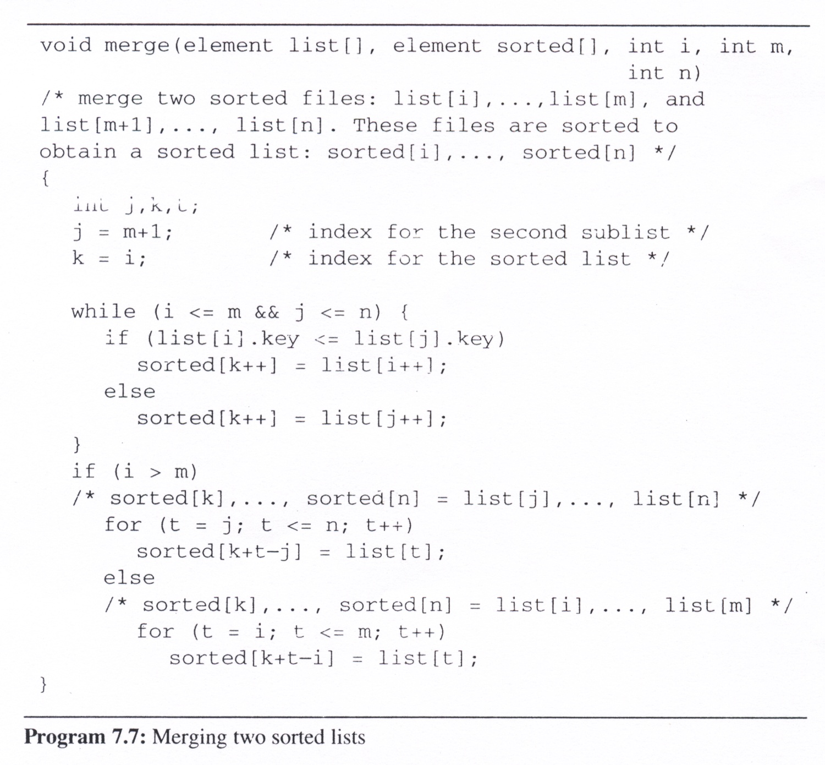
Merge Two Sorted Lists
Notes:
21

Slide 22
Iterative Merge Sort
Iterative merge sort
assume that the input sequence has n sorted lists, each of length 1.
merge these lists pairwise to obtain n/2 lists of size 2.
merge the n/2 lists pairwise, and so on, until a single list remains.
Analysis
Total number of passes is log₂ n
Merging two sorted lists requires linear time: O(n)
The total computing time is O(n log n)
Stable sort
Requires O(n) additional space
Notes:
22

Slide 23
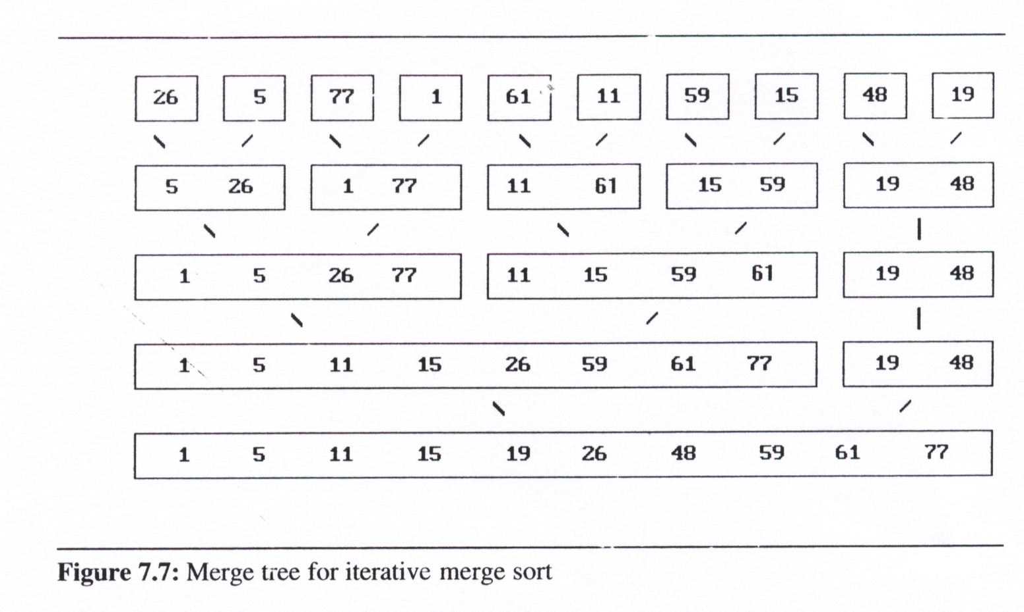
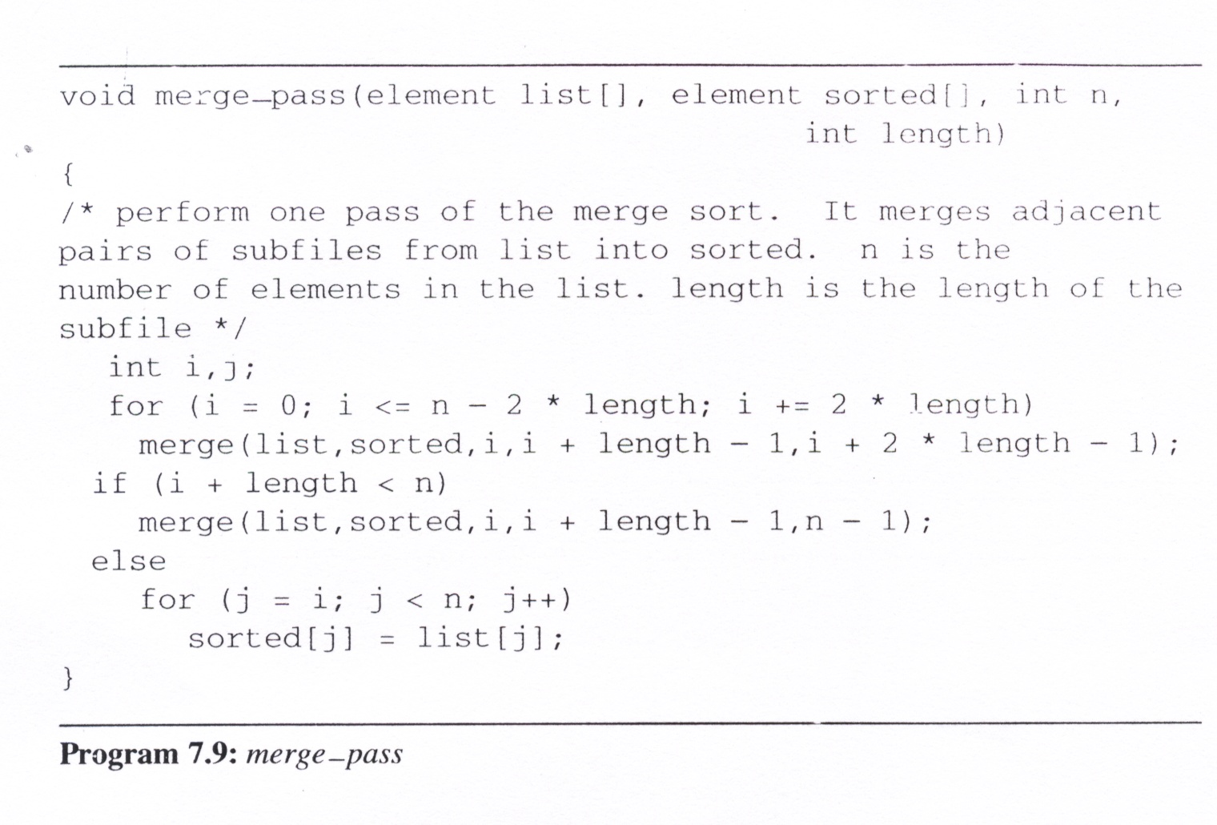
One Iteration of Merge Sort
Perform one pass of the merge sort.
Merge adjacent pairs of sublists into one sorted sublist
use merge to merge two sorted sublists
[0]
[1]
[2]
[3]
[4]
[5]
[6]
[7]
[8]
[9]
length=2
list
n=10
i=
0
4
8
sorted
the length of the sublist
the number of elements in the list
0
4
5
1
3
7
Notes:
23

Slide 24
Iterative Merge Sort
void merge_sort (element list[], int n)
{
int length = 1; /* current merge length */
element extra[MAX_SIZE];
while (length < n) {
merge_pass (list, extra, n, length);
length *= 2;
merge_pass (extra, list, n, length);
length *= 2;
}
length=
1
2
4
8
16
n=10
[0]
[1]
[2]
[3]
[4]
[5]
[6]
[7]
[8]
[9]
list
extra
list
extra
list
Notes:
24

Slide 25
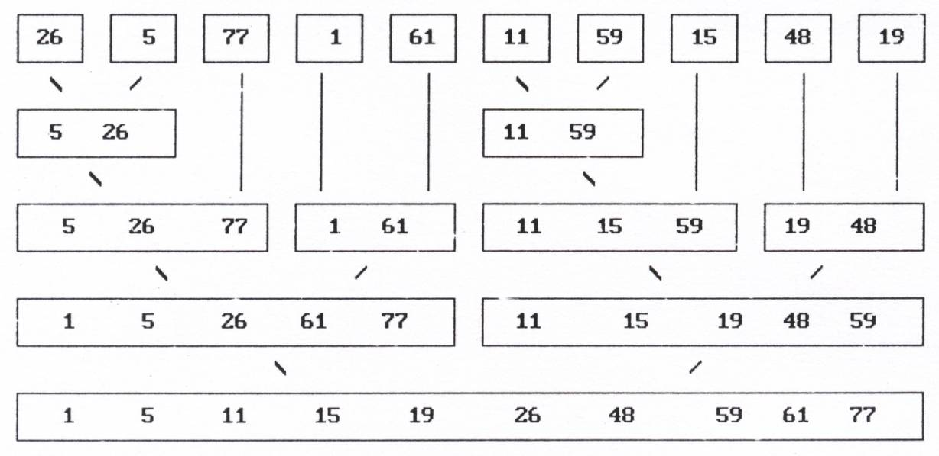
Recursive Merge Sort Concept
Notes:
25

Slide 26
Recursive Merge Sort Implementation
int rmerge (element list[], int lower, int upper)
{
int middle;
if (lower >= upper)
return lower;
else {
middle = (lower + upper) / 2;
return listmerge(list,
rmerge (list, lower, middle),
rmerge (list, middle+1, upper));
}
}
lower=
0
1
0
2
0
3
4
3
0
5
6
5
7
5
8
9
8
5
0
upper=
2
4
9
4
2
1
0
1
4
3
9
7
6
5
6
7
9
8
9
middle=
4
2
1
0
1
2
3
2
4
7
6
5
6
7
8
7
4
0
3
0
5
8
5
0
1
2
4
3
6
7
9
8
5
list
[0]
[1]
[2]
[3]
[4]
[5]
[6]
[7]
[8]
[9]
start = rmerge(list, 0, n-1);
Notes:
26

Slide 27
Practice Time
Please sort the following data sequence by merge sort
6 5 3 1 8 7 2 4

Slide 28
Recursive Merge Sort
Algorithm
Recursively divide the list into length 1 sublists
Recursively merge pairwise sublists until a single list remains
Analysis
The total computing time is O(n log n).
Still requires O(1) additional space for the partially sorted lists
Stable

Slide 29
Heap Sort

Slide 30
Heap Sort Ideas
Build a heap from the given list of elements (keys)
Sort into Ascending (Descending) order
Adjust the heap into a Max (Min) heap
Do from last non-leaf node up to root node
Maintain Max (Min)-heap of the sub-tree rooted at the current node
Adjust the heap into a Min (Max) heap
Do from last node up to root node
Swap current node with the root [Max (Min)] node and adjust
Notes:
30

Slide 31
Heap Sort: Implementation
n = 10
void heapsort (element list[], int n)
/* perform a heapsort on the array */
{
int i, j;
element temp;
for (i=n/2; i>0; i--)
adjust (list, i, n);
for (i=n-1; i>0; i--) {
SWAP (list[1], list[i+1], temp);
adjust (list, 1, i);
}
}
i =
5
4
3
2
1
9
8
7
6
5
4
3
2
1
ascending order (max heap)
bottom-up
[1]
26
61
48
19
77
1
59
26
15
11
5
1
5
1
5
1
1
5
1
top-down
[2]
5
77
15
61
5
1
5
[3]
11
59
26
11
48
1
19
1
61
11
59
48
15
15
1
[4]
[5]
19
19
5
26
1
[6]
[7]
26
48
1
15
48
77
[8]
59
19
5
[9]
1
61
5
[10]
Notes:
31

Slide 32
Heap Sort: Adjusting the Heap
root = 1
void adjust (element list[], int root, int n)
{
int child, rootkey;
element temp;
temp = list[root];
rootkey = list[root].key;
child = 2*root; /* left child */
while (child <=n) {
if ((child < n) && (list[child].key < list[child+1].key))
child++;
if (rootkey > list[child].key)
break;
else { /* move to parent */
list[child/2] = list[child];
child *=2;
}
}
list[child/2] = temp;
}
n = 10
rootkey =
26
child =
2
3
6
7
14
[1]
77
26
5
77
[2]
[3]
59
1
61
11
26
[4]
[5]
[6]
[7]
59
[8]
15
[9]
48
19
[10]
Notes:
32

Slide 33
Practice Time
Please sort the following data sequence by heap sort
6 5 3 1 8 7 2 4

Slide 34
Heap Sort
The worst case and average computing time is O(n log n), same as merge sort
Require only a fixed amount of additional storage
Slightly slower than iterative merge sort that uses O(n) additional space
Faster than recursive merge sort that uses O(1) additional space.
Unstable
Notes:
34

Slide 35
Radix Sort

Slide 36
Radix Sort Problem Definition
sorting records that have several keys
Keys are labeled K⁰ (most significant key), K¹, … , K^{r-1} (least significant key).
Let K_{i} ^{j} denote key K^{j} of record R_{i}
A list of records R₀, … , R_{n-1}, is lexically sorted with respect to the keys K⁰, K¹, … , K^{r-1} iff (K_{i}⁰, K_{i}¹, …, K_{i}^{r-1}) ≤ (K⁰_{i+1}, K¹_{i+1}, …, K^{r-1}_{i+1}), 0 ≤ i < n-1
Notes:
36

Slide 37
Radix Sort Examples
Sorting a deck of cards on two keys,
suit and face value
K⁰ [Suit]: Club < Diamond < Heart < Spade
K¹ [Face value]: 2 < 3 < 4 < … < 10 < J < Q < K < A
sorted deck of cards has the ordering: 2C, …, AC, 2D, …, AD, 2H, …, AH, 2S, …, AS
Sorting list of numbers digit by digit
180, 523, 020, 023
MSD (Most Significant Digit) first: sort on K₀, then K₁, ...
LSD (Least Significant Digit) first: sort on K_{r-1}, then K_{r-2}, ...
Notes:
37

Slide 38
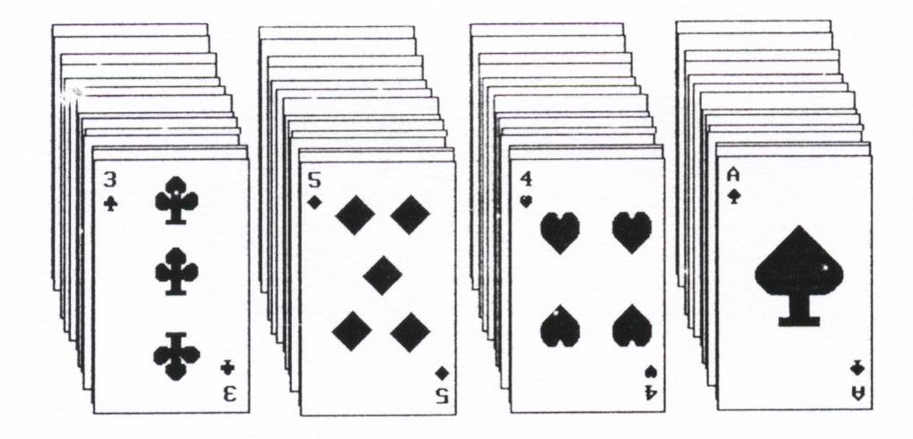
Radix Sort MSD First
MSD first
sort MSD first, e.g.,suit → four bins C, D, H, S
sort each bin on LSD, e.g., face value
Result: 2C, …, AC, … , 2S, … , AS
Please bins on top of each other to get final sorted list.
Notes:
38

Slide 39
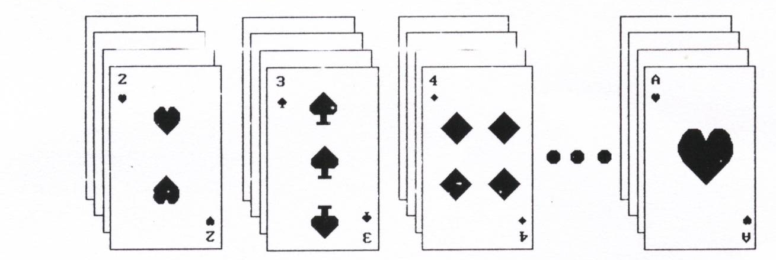
Radix Sort LSD First
LSD first
sort LSD first, e.g., face value →13 bins 2, 3, 4, …, 10, J, Q, K, A
Place 2 bin on top of 3 bin on top of 4 bin … on top of A bin
Now sort on MSD, e.g., suit → 4 bins
Result:
2C, …, AC,
. . .
2S, …, AS
Notes:
39

Slide 40
Radix Sort LSD First
Example
Original list: 170, 045, 075, 090, 002, 024, 802, 066
K²: (170, 090), (002, 802), (024), (045, 075), (066)
=> 170, 090, 002, 802, 024, 045, 075, 066
K¹: (002, 802), (024), (045), (066), (170, 075), (090)
=> 002, 802, 024, 045, 066, 170, 075, 090
K⁰: (002,024,045,066,075,090), (170), (802)
=> 002, 024, 045, 066, 075, 090, 170, 802
Need to have buckets of lists
Buckets for digit 0, 1, 2, 3, …, 9
Buckets can be reused, need not be saved

Slide 41
Radix Sort MSD First
Example
Original list: 170, 045, 075, 090, 002, 024, 802, 066
K⁰: (045, 075, 090, 002, 024, 066), (170), (802)
K¹: (002), (024), (045), (066), (075), (090), (170), (802)
K²: Same as above
=> 002, 024, 045, 066, 075, 090, 170, 802
Need to have buckets of lists
Buckets for digit 0, 1, 2, 3, …, 9
Buckets may need to be saved, cannot be reused

Slide 42
Radix Sort
radix sort
decompose the sort key into digits using a radix r.
Ex: When r =10, we get the common base 10 or decimal decomposition of the key
#define MAX_DIGIT 3 /* 0 to 999 */ #define RADIX_SIZE 10 typedef struct list_node *list_pointer;
typedef struct list_node {
int key[MAX_DIGIT];
list_pointer link;};
Notes:
42

Slide 43
Radix Sort
LSD radix r sort
The records, R₀, … ,R_{n-1}
Keys: d-tuples (x₀, x₁, …, x_{d-1}) and that 0 ≤ x_{i} < r.
Each record has a link field, and that the input list is stored as a dynamically linked list.
We implement the bins (buckets) as queues
front[i], 0 ≤ i < r, pointing to the first record in bin i
rear[i], 0 ≤ i < r, pointing to the last record in bin i
Notes:
43

Slide 44
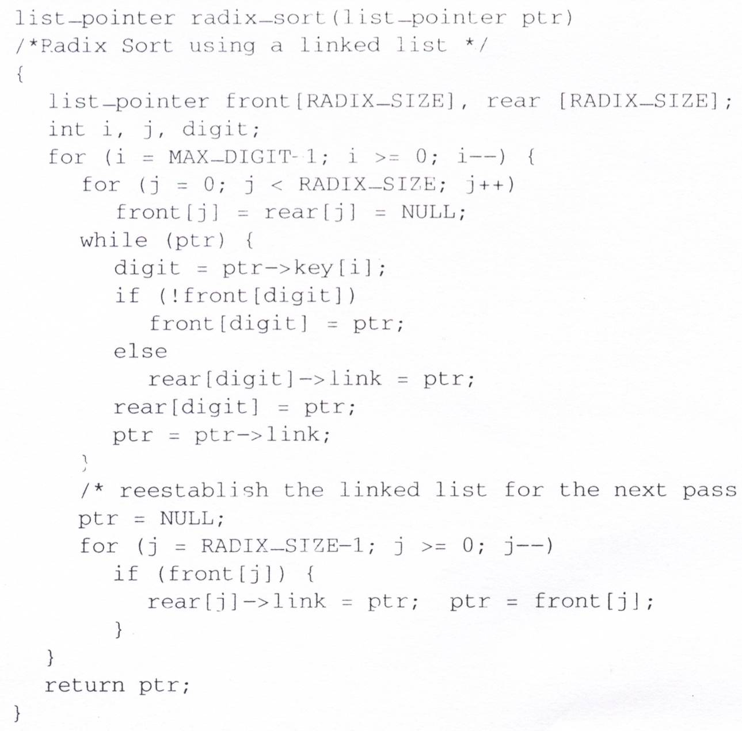
LSD Radix Sort
RADIX_SIZE = 10
MAX_DIGIT = 3
Initial input: 179→208→306→93→859 →984→55→9→271→33
MAX_DIGIT passes
O(RADIX_SIZE)
f[0]
r[0]
O(n)
f[1]
271
NULL
r[1]
f[2]
r[2]
f[3]
93
33
NULL
r[3]
f[4]
984
NULL
r[4]
f[5]
55
NULL
r[5]
O(RADIX_SIZE)
f[6]
306
NULL
r[6]
f[7]
r[7]
f[8]
208
NULL
r[8]
f[9]
179
Chain after first pass, i=2: 271→93→33→984→55→ 306→208→179→859→9
859
9
NULL
r[9]
Time complexity: O(MAX_DIGIT*(RADIX_SIZE+n))
Notes:
44

Slide 45
Radix Sort Simulation
Chain after first pass, i=2: 271→93→33→984→55→ 306→208→179→859→9
f[0]
306
Chain after second pass, i=1: 306→208→9→33 →55→859→271 →179→984→93
f[0]
9
Chain after third pass, i=0: 9→33→55→93 →179→208→271 →306→859→984
208
33
9
NULL
r[0]
55
f[1]
r[1]
93
NULL
r[0]
f[2]
r[2]
f[1]
179
NULL
r[1]
f[3]
33
NULL
r[3]
f[2]
208
f[4]
55
271
NULL
r[2]
859
r[4]
f[3]
306
NULL
r[3]
NULL
f[5]
r[5]
f[4]
r[4]
f[6]
r[6]
f[5]
r[5]
f[7]
271
r[7]
f[6]
r[6]
179
NULL
f[7]
r[7]
f[8]
984
NULL
r[8]
f[8]
859
NULL
r[8]
f[9]
93
NULL
r[9]
f[9]
984
r[9]
NULL
Notes:
45

Slide 46
Internal Sorting Summaries

Slide 47
Summaries
Insertion Sort
Works well when the list is already partially ordered
The best sorting method for small n
Merge Sort
The best/worst case (O(n log n))
Require more storage than a heap sort
Slightly more overhead than quick sort
Quick Sort
The best average behavior (O(n log n))
The worst complexity in worst case (O(n²))
Radix Sort
Depend on the size of the keys and the choice of the radix
Notes:
47

Slide 48
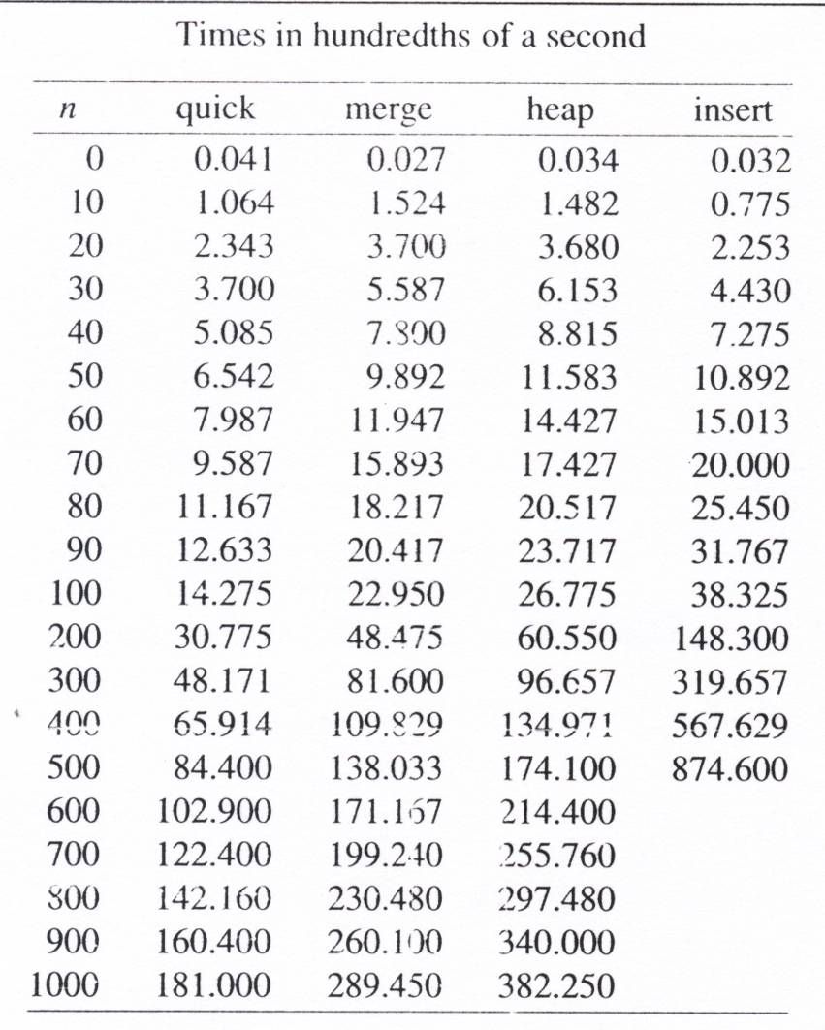
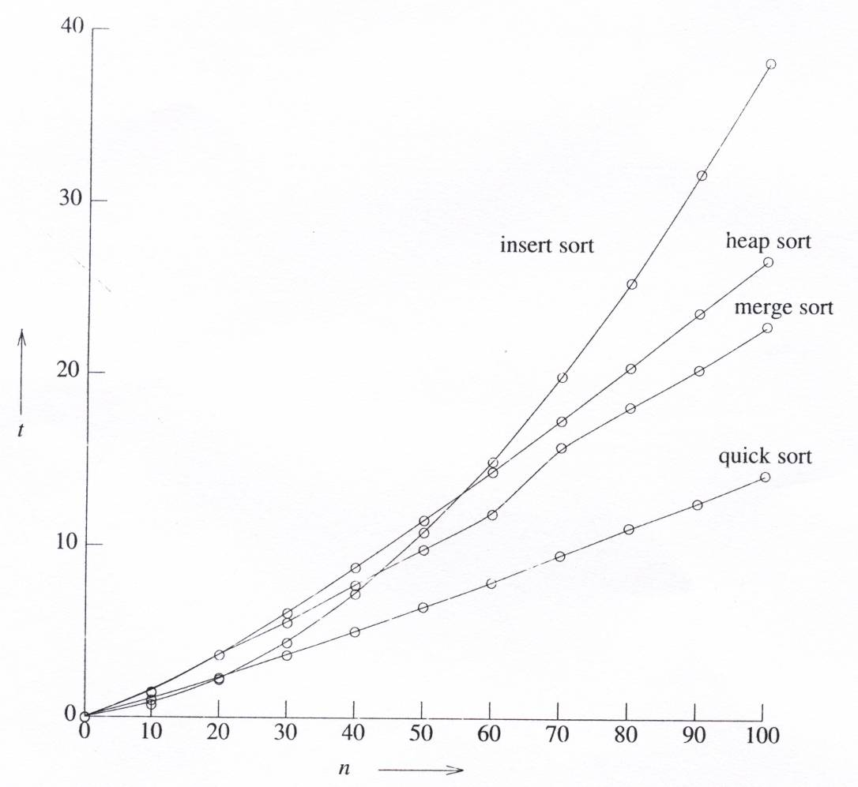
Summary Average Running times
Notes:
48

Slide 49
External Sort

Slide 50
Large Data Sorting Scenario
Consider a computer with capacity of sorting 750 records at once is used to sort 4500 records.
Six runs are generated with each run sorting 750 records.
Allocate three 250-record blocks of internal memory for performing merging runs.
Two for input runs and the last one for output.
Three factors contributing to the I/O time:
seek time t_{s}
latency time t_{l}
transmission time t_{rw}
t_{IO} = t_{s} + t_{l} +t_{rw}

Slide 51
External Sort
run2 (751 – 1500)
run3 (1501 – 2250)
run4 (2251 – 3000)
run5 (3001 – 3750)
run6 (3751 – 4500)
run1 (1 – 750)

Slide 52
Time Requirement
t_{IO} = t_{s} + t_{l} +t_{rw}
t_{s} = maximum seek time
t_{l} = maximum latency time
t_{rw} = time to read or write on block of 250 records
t_{IS} = time to internal sort 750 records (3 blocks)
t_{m} = time to merge m records from input buffers to the output buffer

Slide 53
Time Requirement
run1 (1 – 750)
run2 (751 – 1500)
run3 (1501 – 2250)
run4 (2251 – 3000)
run5 (3001 – 3750)
run6 (3751 – 4500)
 | Operation | Time
(1) | Read 18 blocks of input: 18t_{IO}, internally sort: 6t_{IS} , write 18 blocks: 18t_{IO} | 36t_{IO} + 6t_{IS}
(2) | Merge runs 1 to 6 in pairs | 36t_{IO} + 4500t_{m}
(3) | Merge two runs of 1500 records each (12 blocks) | 24t_{IO} + 3000t_{m}
(4) | Merge one run of 3000 records with one run of 1500 records (18 blocks) | 36t_{IO} + 4500t_{m}
 | Total time | 132t_{IO} + 12000t_{m}+ 6t_{IS}

Slide 54
Speed up with Parallelism
Carry out the CPU operation and I/O operation in parallel
Total Time = 132 t_{IO} + 12000 t_{m} + 6 t_{IS}
Two disks: 132 t_{IO} is reduced to 66 t_{IO}

Slide 55
k-way Merging
1 2 3 4
1 2 3 4
1 2 3 4
1 2 3 4
A 4-way merge on 16 runs
2 passes (4-way) vs. 4 passes (2-way)

Slide 56
Optimal Merging of Runs
26
26
11
15
6
20
6
5
2
4
5
15
2
4
weighted external path length = 2*3 + 4*3 + 5*2 + 15*1
= 43
weighted external path length = 2*2 + 4*2 + 5*2 + 15*2
= 52
Construct Huffman tree to find optimal merging structure
iteratively combining two subtrees of minimum weights

Slide 57
Huffman Tree Example
2
3
5
7
9
13
5
10
16
2
3
5
5
9
7
Round 3
2
3
Round 1
39
Round 2
23
16
23
10
13
9
7
10
13
5
5
5
5
2
3
Round 4
Round 5
2
3

Slide 58
Summary
Internal Sorting Algorithms
Insertion Sort
Quick Sort
Merge Sort
Heap Sort
Radix Sort
External Sorting Algorithm
K-way Merging
Notes:
58

